Slide 1
Alcohol Delivery System by Sam Schaefer

Slide 2
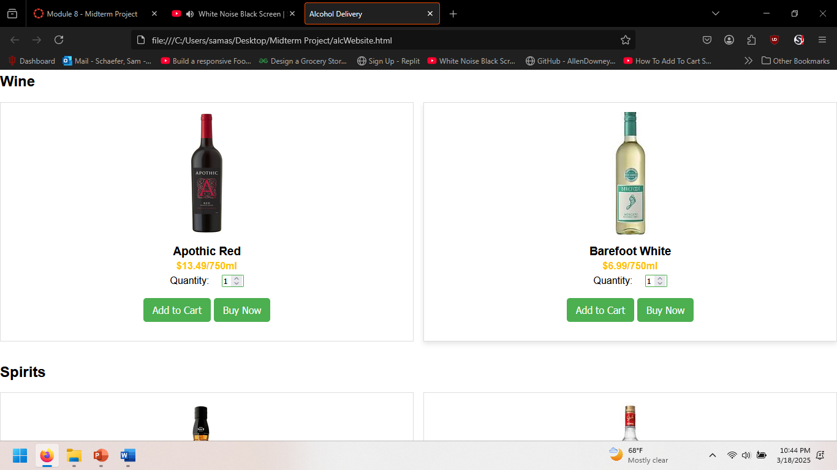
Features:
Cart Functions
Secure Payment Processing
Real-Time Order Tracking
Age Verification System
Product Catalog
User Accounts & Order History

Slide 3
System Requirements
Frontend: HTML, CSS, JavaScript
Backend: Node.js, Express.js (not done yet)
Database: SQL
Hosting: Not sure yet
Supported Browsers: Chrome, Firefox, Edge, Safari
Device Compatibility: Desktop, Tablet, Mobile

Slide 4
Plans for the Future
Payment Authentication
Delivery Tracking.
User Login Authentication
Stored History

